Slide 1

CS 319 - Term Project
Final Presentation
3H - Bilpoly
Ömer Ünlüsoy 21702136
Arda Akça Büyük 21802835
İrem Tekin 21803267
Ece Ünal 21703149
Furkan Ahi 21501903

Slide 2

Bilpoly Trailer

Slide 3
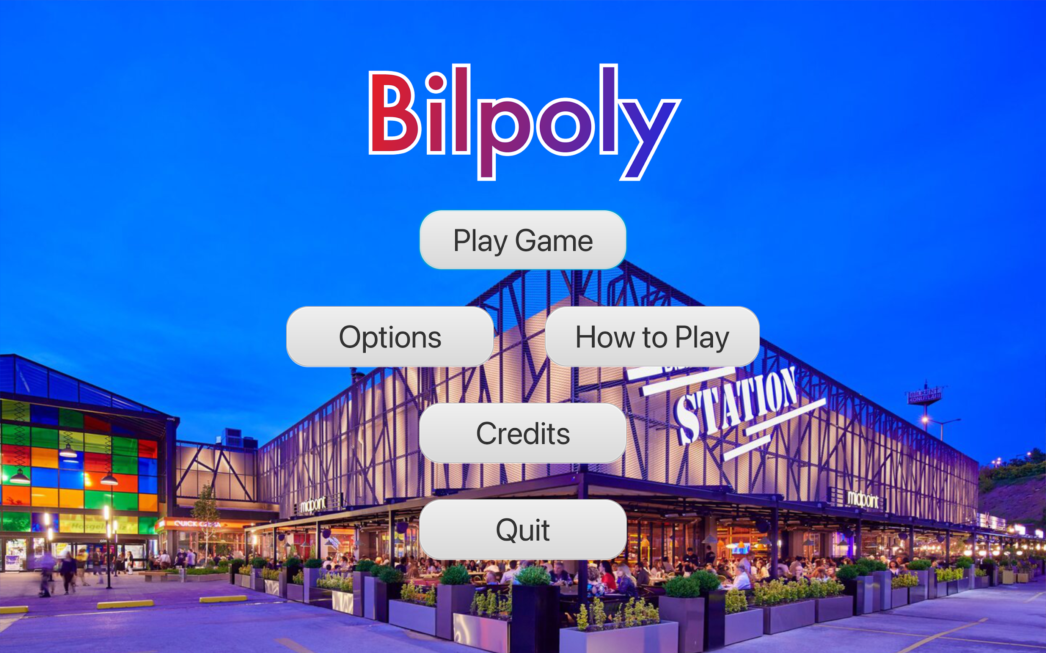
Introduction
Monopoly Bilkent Edition
Why?
We miss Bilkent
Exclusive for Bilkent members with inside jokes
Imitation of daily student conversation topics

Slide 4
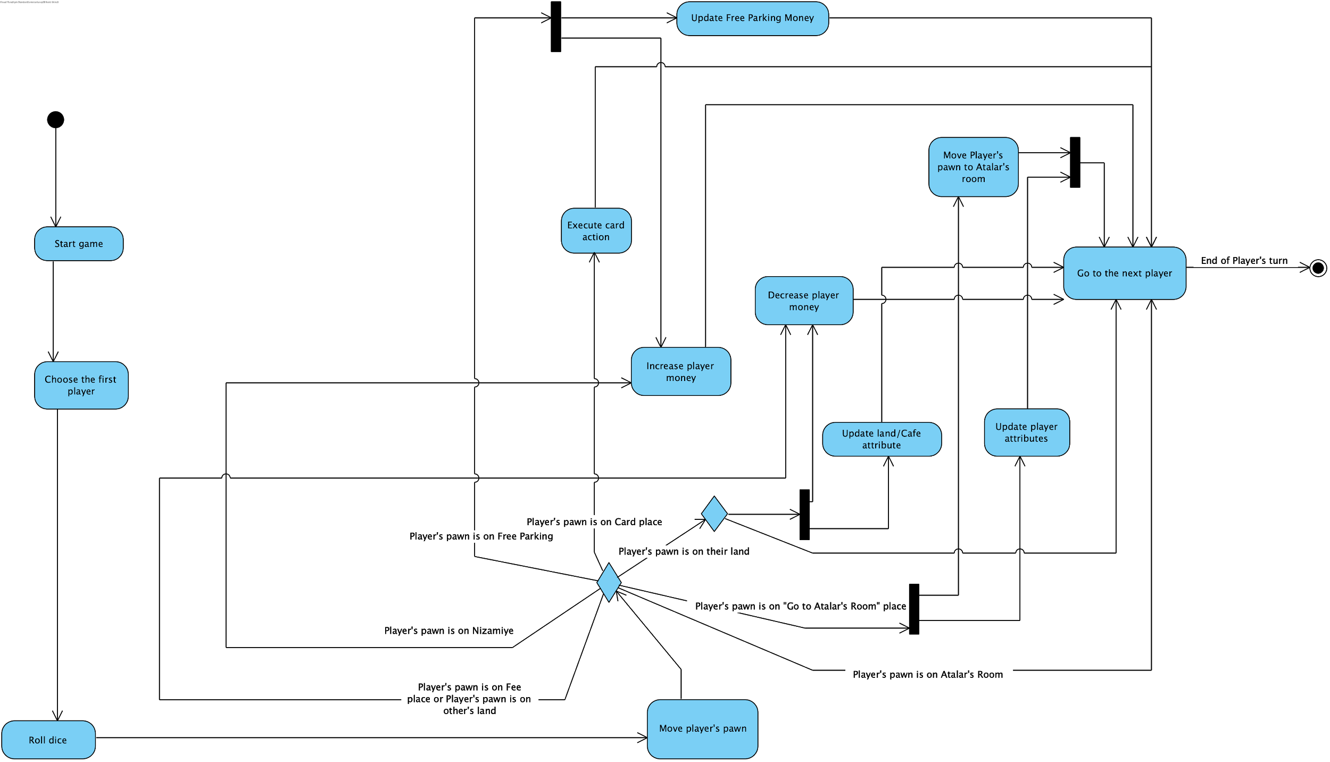
Activity Diagram

Slide 5
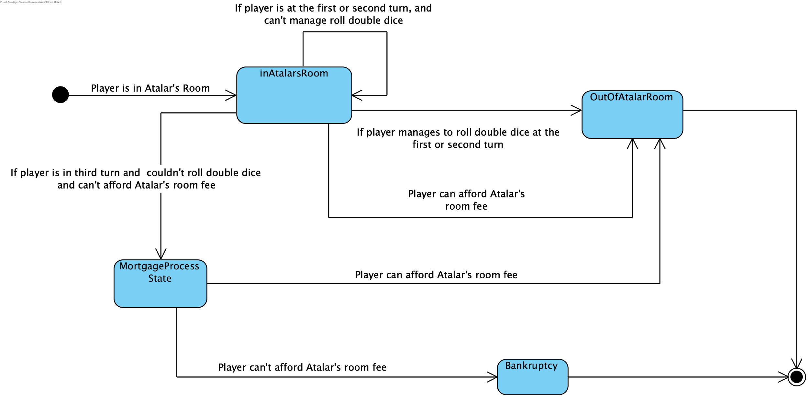
State Diagram

Slide 6
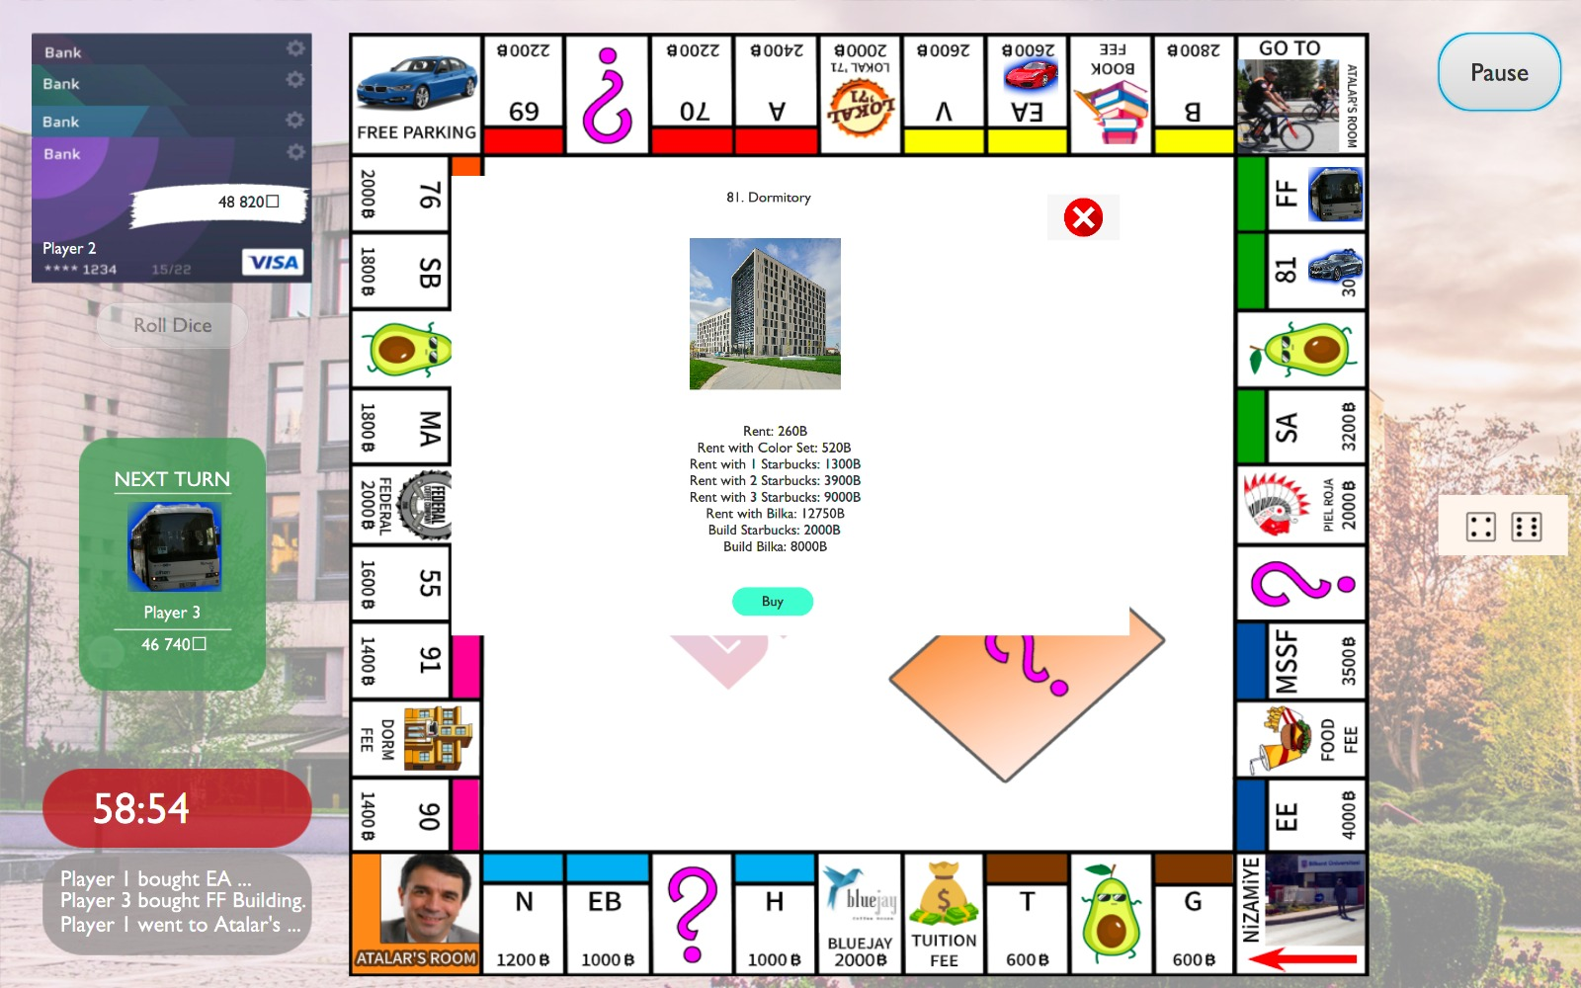
Additional Features of Bilpoly
Game Music
Background Selection
Free Parking Rule
History Panel
Randomised Chance & Rector’s Whisper Cards

Slide 7
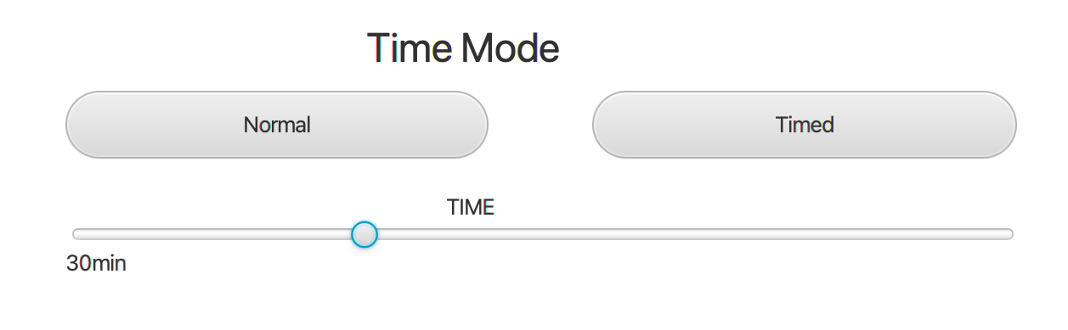
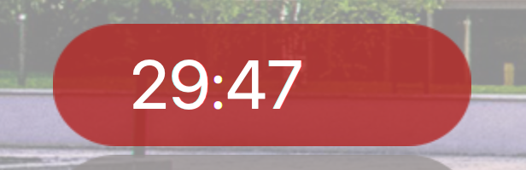
Timed Mode
Adjustable Slider
Timer Panel
Game Over Screen

Slide 8
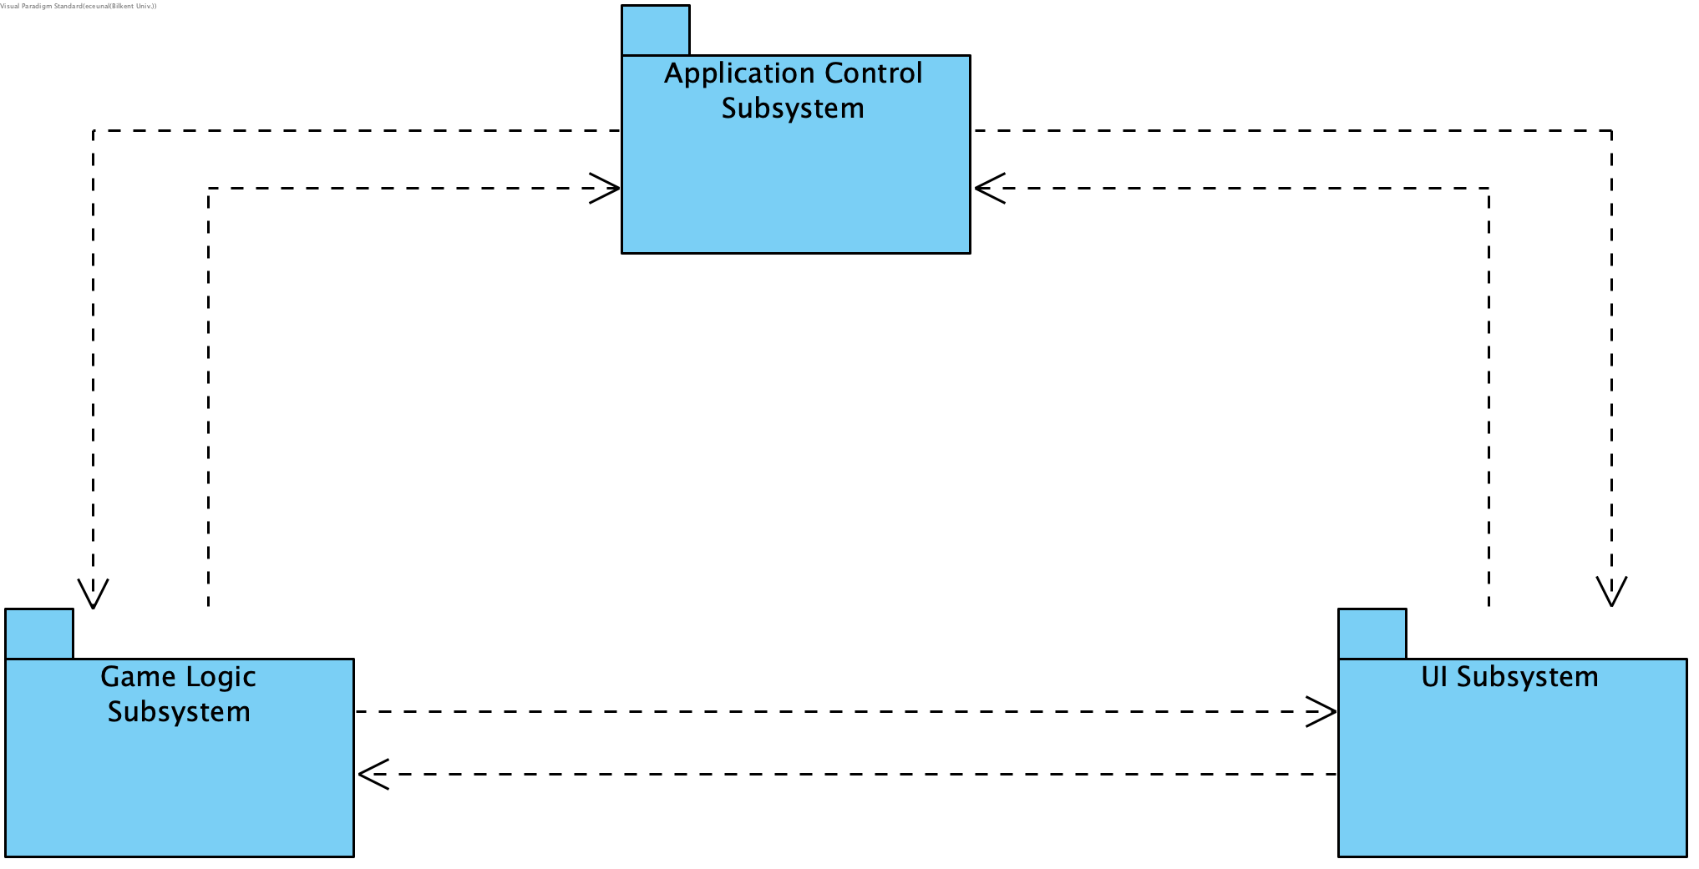
Subsystem Decomposition
Notes:
In here
we have three subsystems
Application Control
Game Logic
UI Subsystem
All packages here depends on each other.
So we can manage to change things in a package
From a different package.
For example,
We got the player name and selected pawn information from UI,
And this data is sent to the Application control subsystem after that we use these info to initialize the game. Also in game logic, there is a data flow between UI and game logic because we changed the history label in UI.

Slide 9
Class Diagram

Slide 10
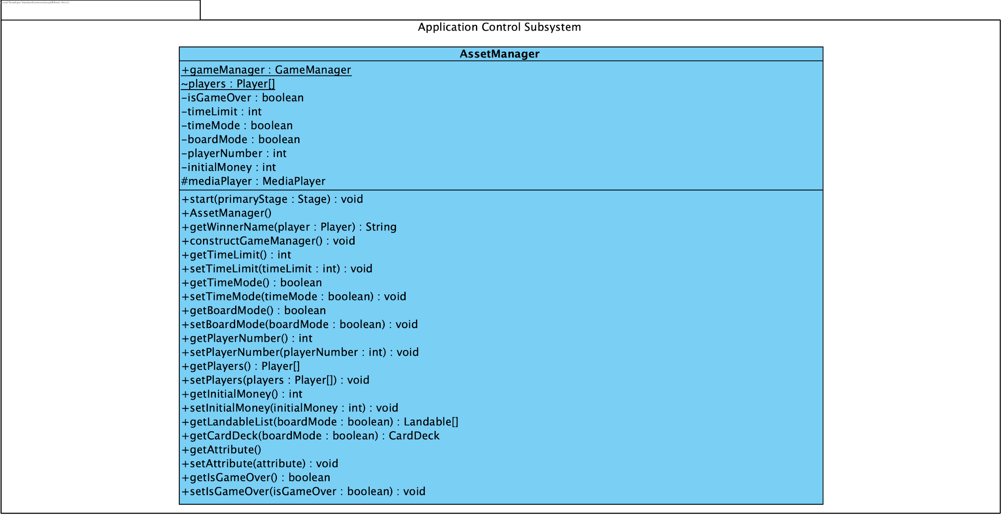
Application Control Subsystem

Slide 11
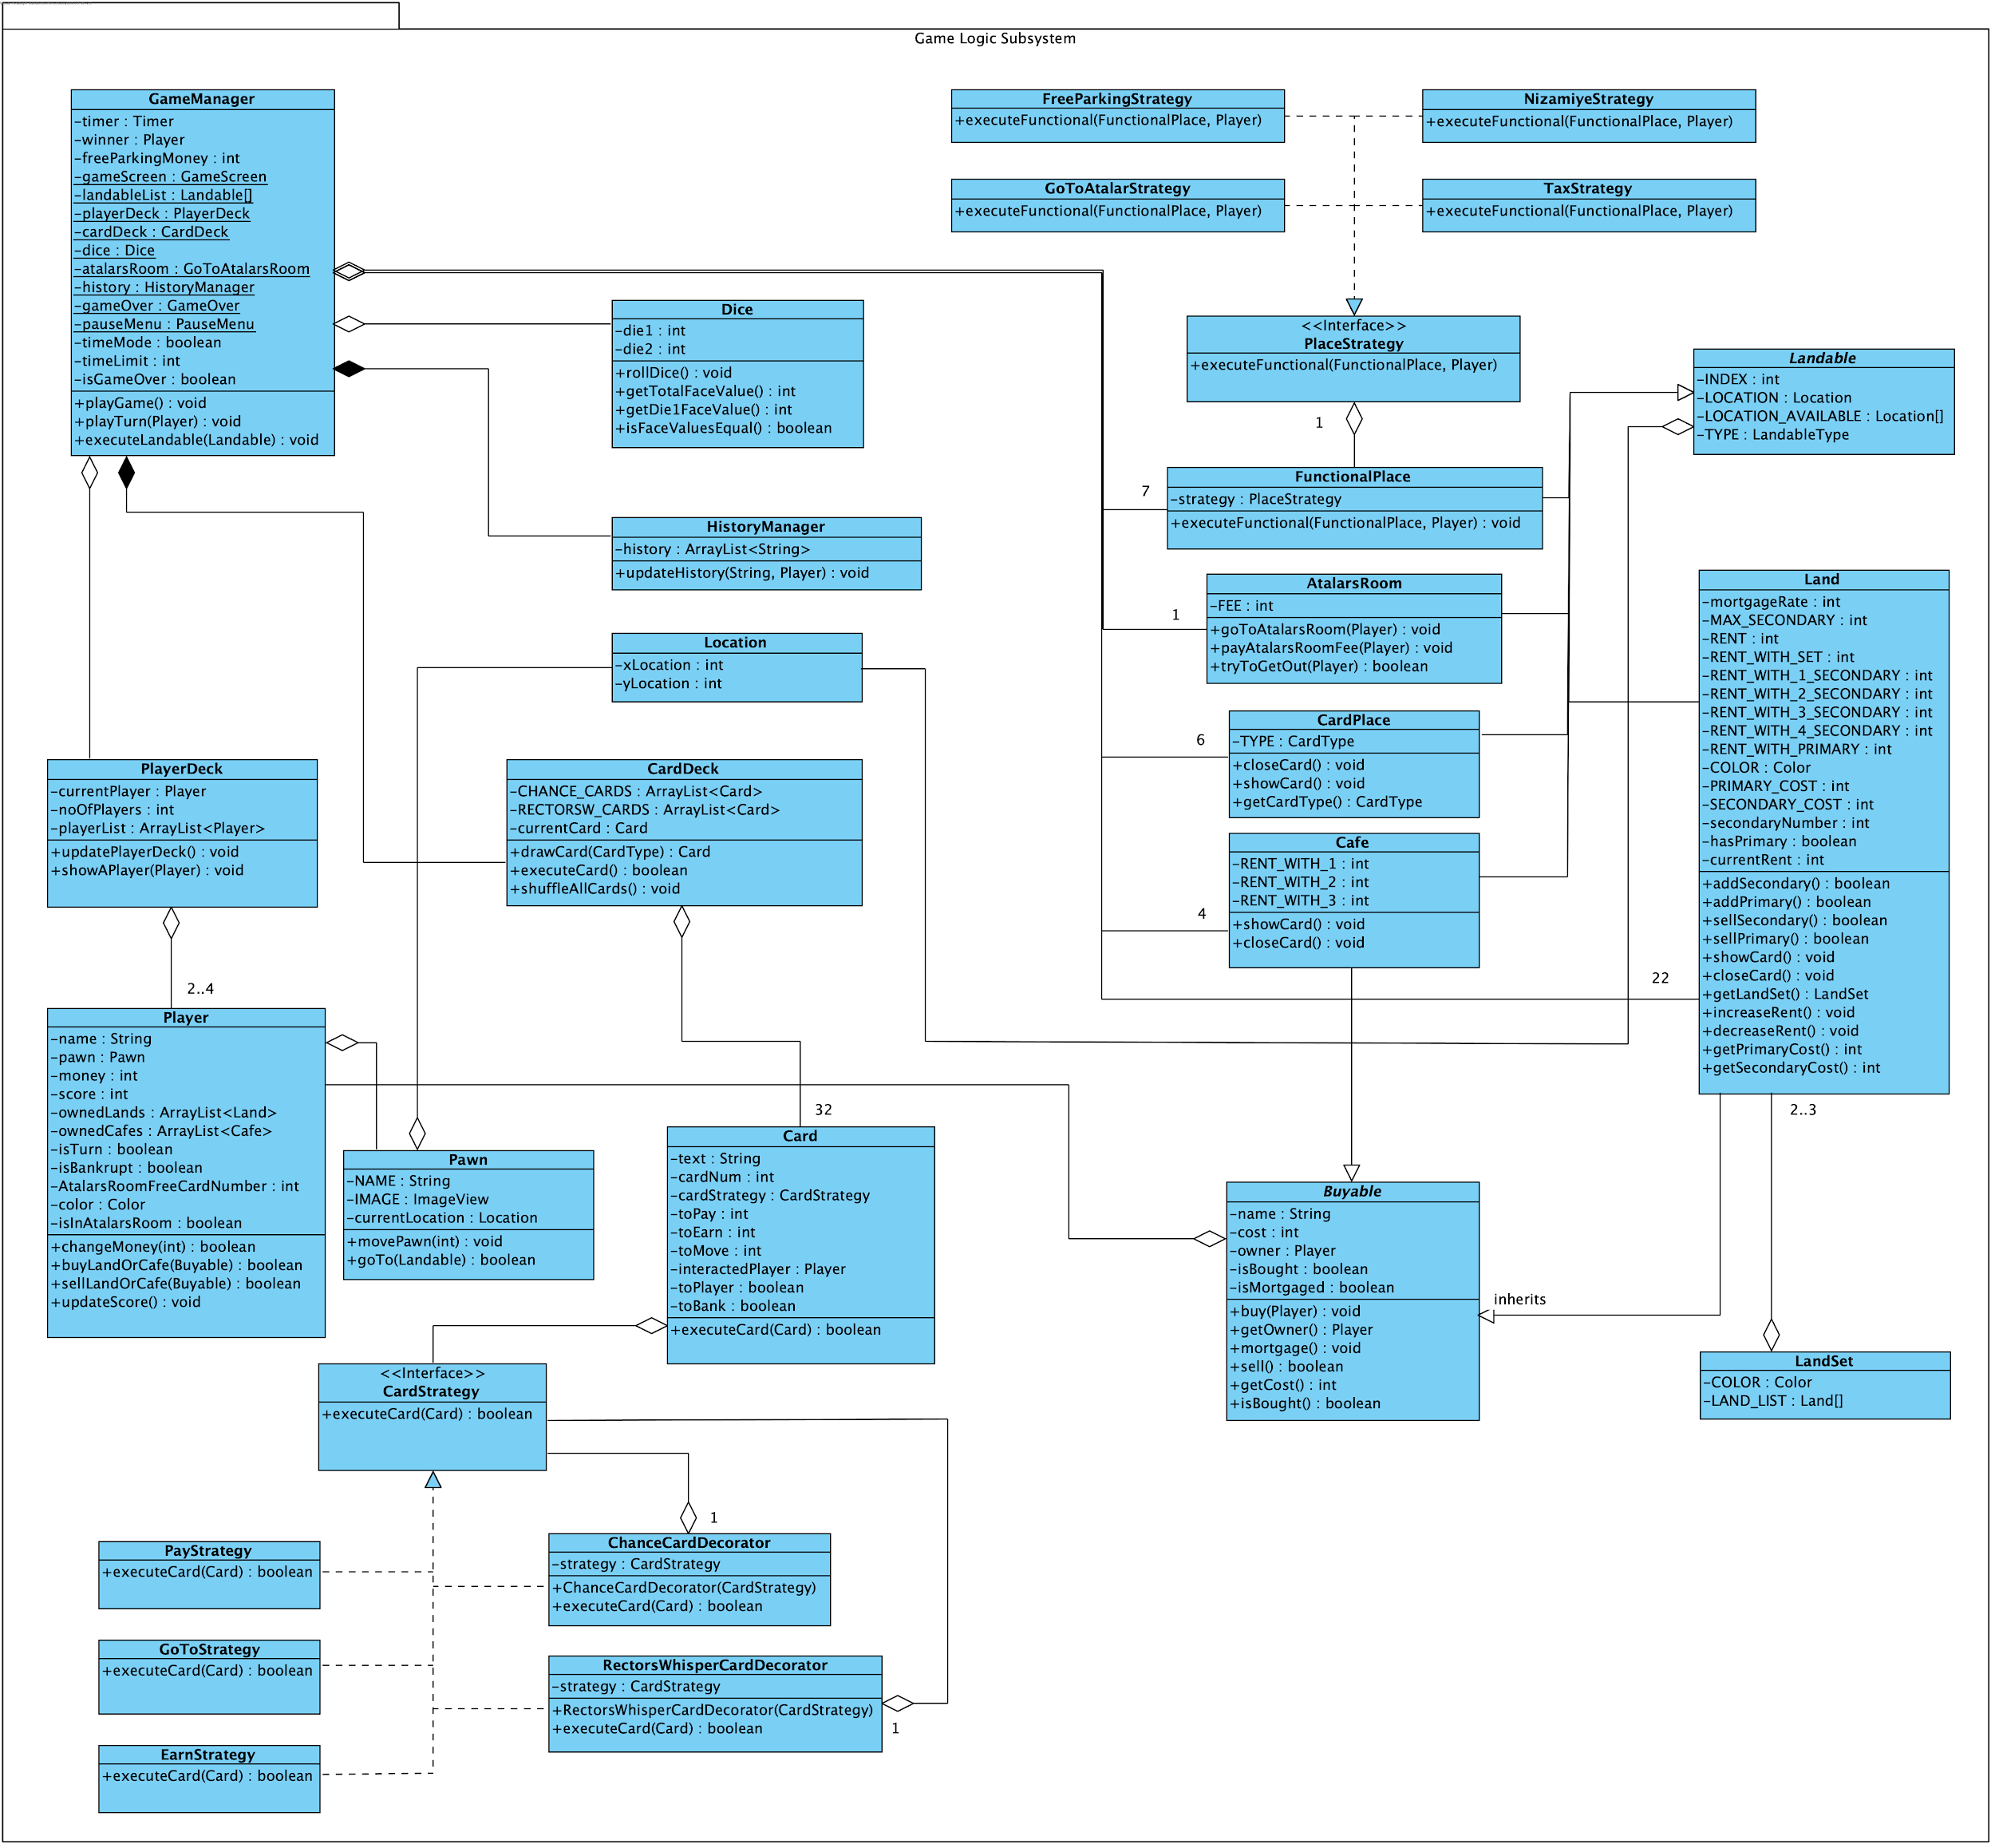
Game Logic Subsystem

Slide 12
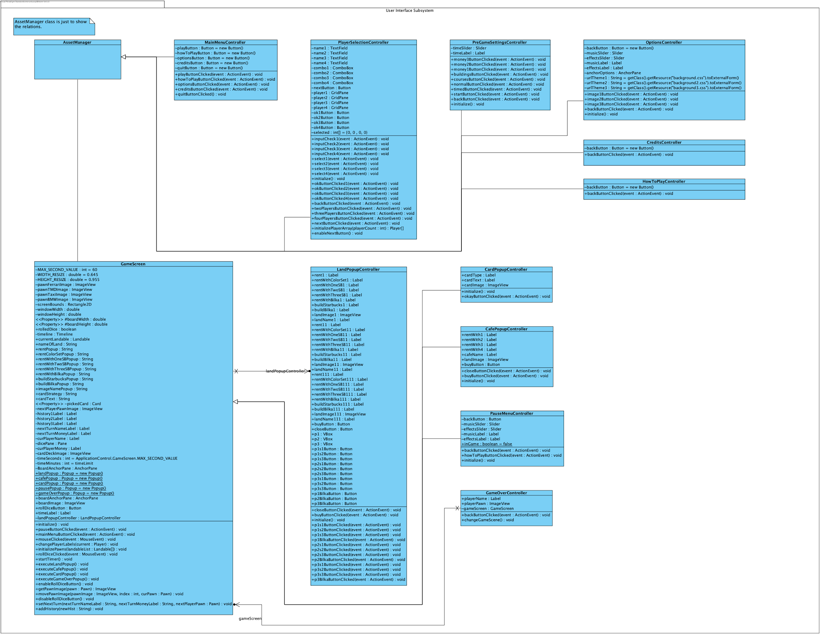
User Interface Subsystem

Slide 13
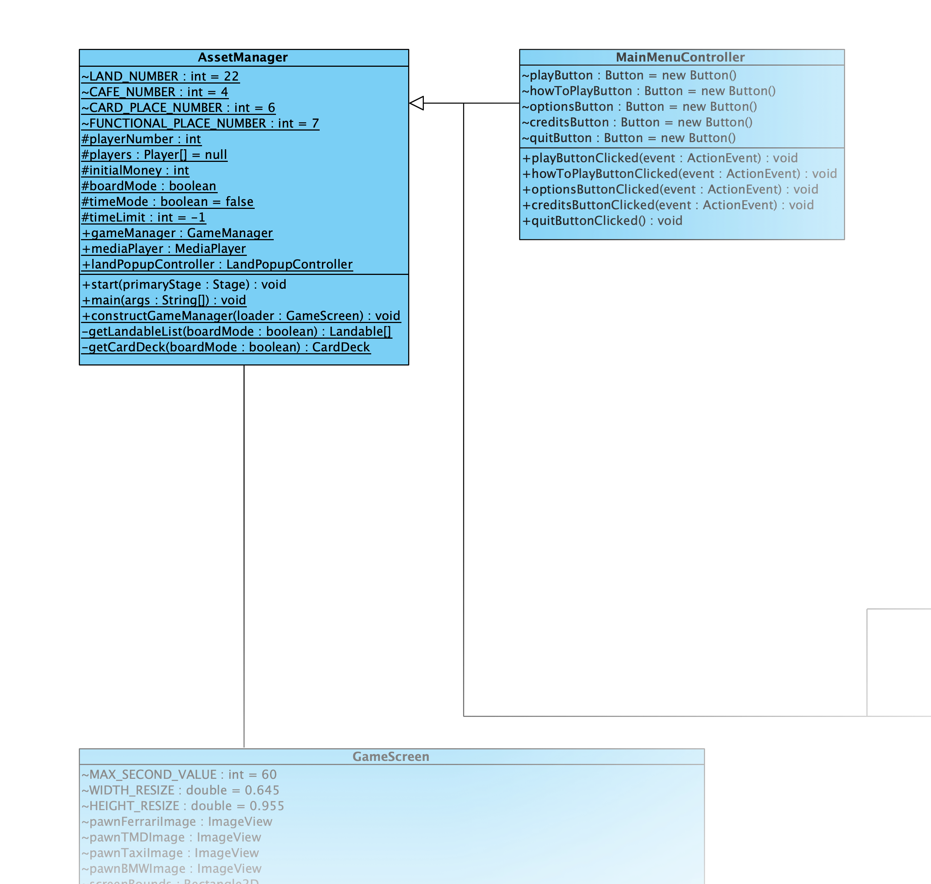
Class Diagram
Asset Manager
Main manager class
Handles Main Menu
Initializes Game Manager
Reads Land and Card text files

Slide 14
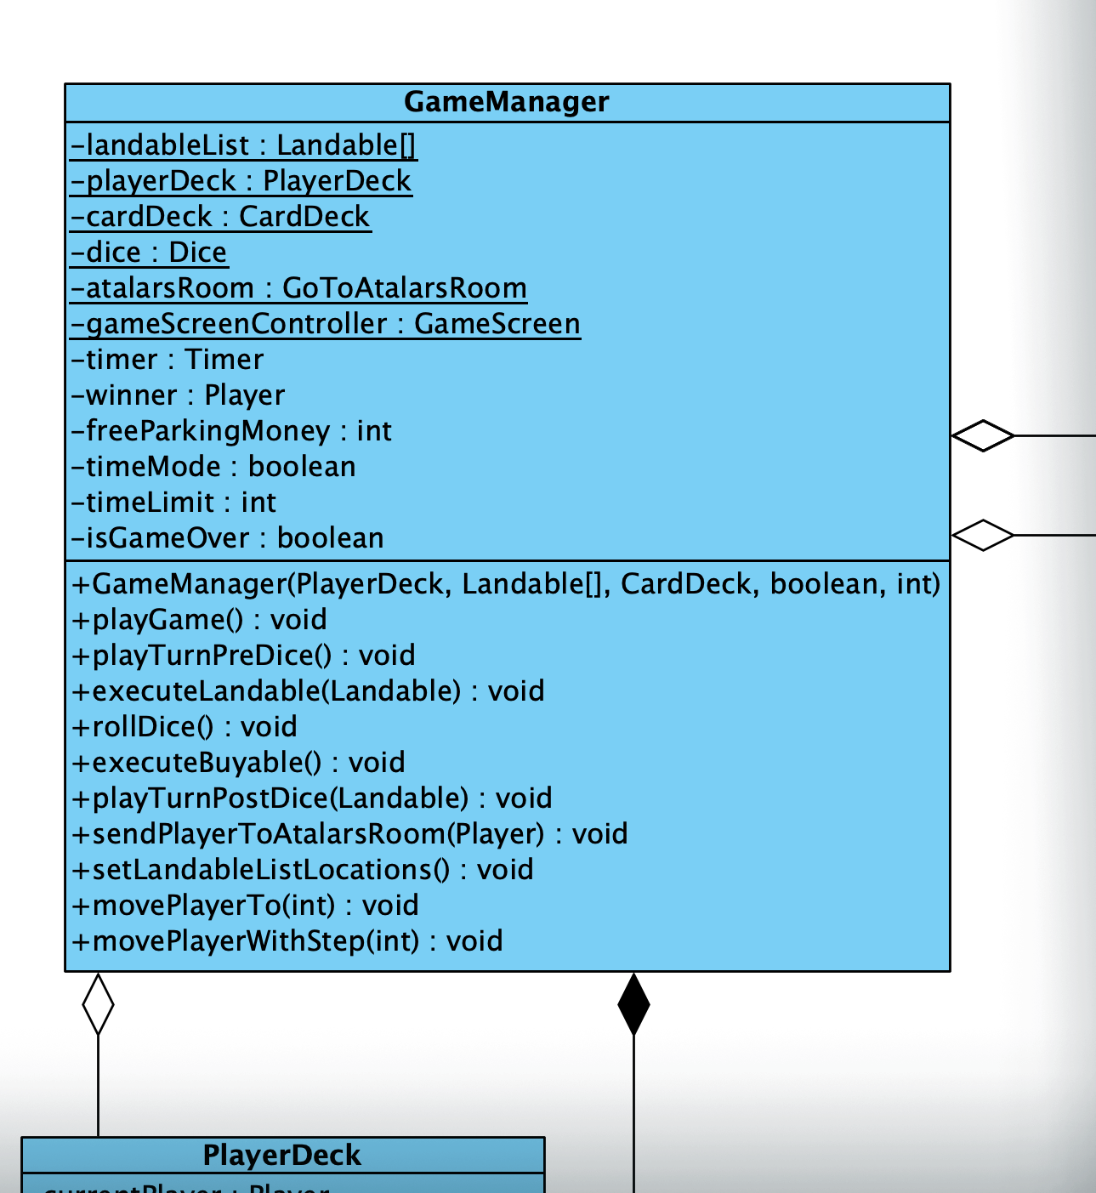
Class Diagram
Game Manager
Manager of Game
Handles Board and Player Turns
Handles Player Deck and Card Deck
Communicates with Game Screen class

Slide 15
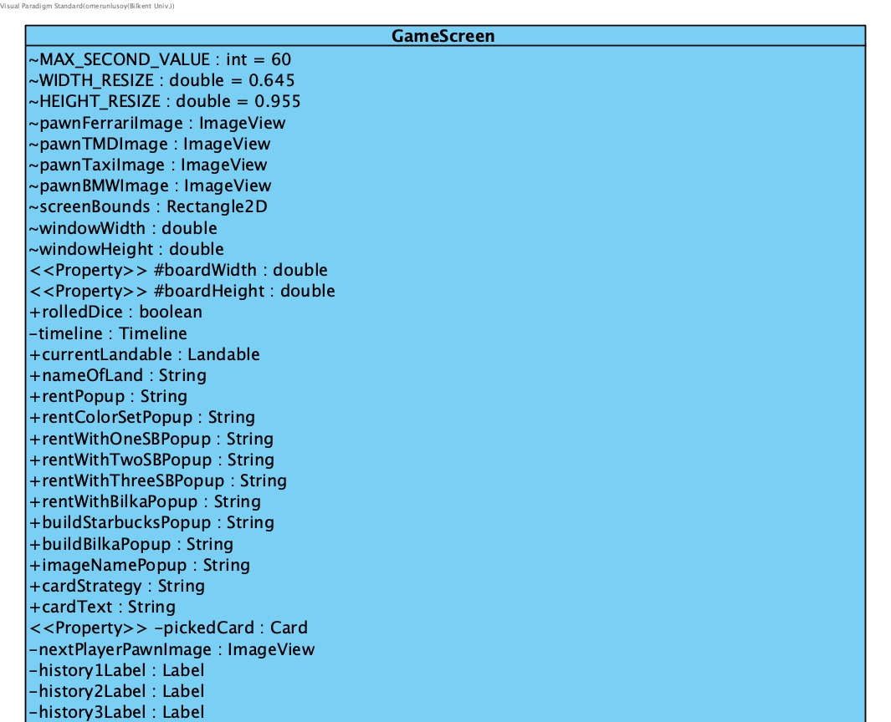
Class Diagram
Game Screen
Game User Interface
Handles User Inputs
Includes Board, Player Deck, Dice, History, and Next Turn
Handles Pawn movement

Slide 16
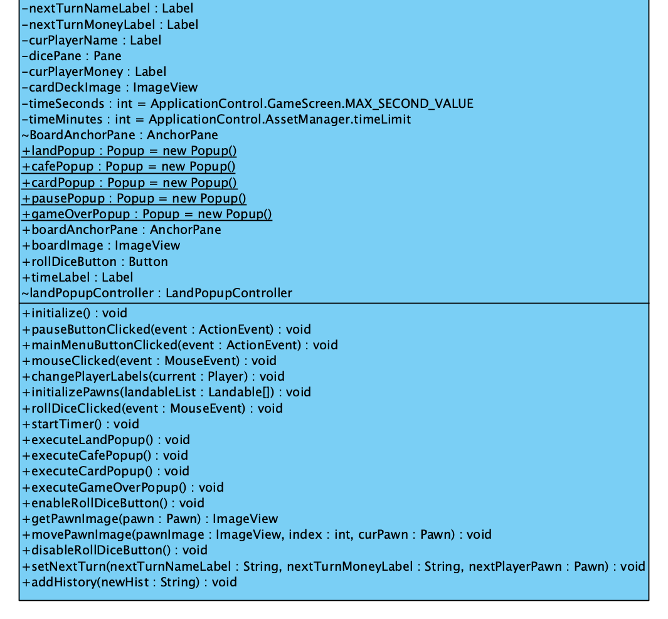
Class Diagram
Game Screen
Game User Interface
Handles User Inputs
Includes Board, Player Deck, Dice, History, and Next Turn
Handles Pawn movement

Slide 17
Design Patterns

Slide 18
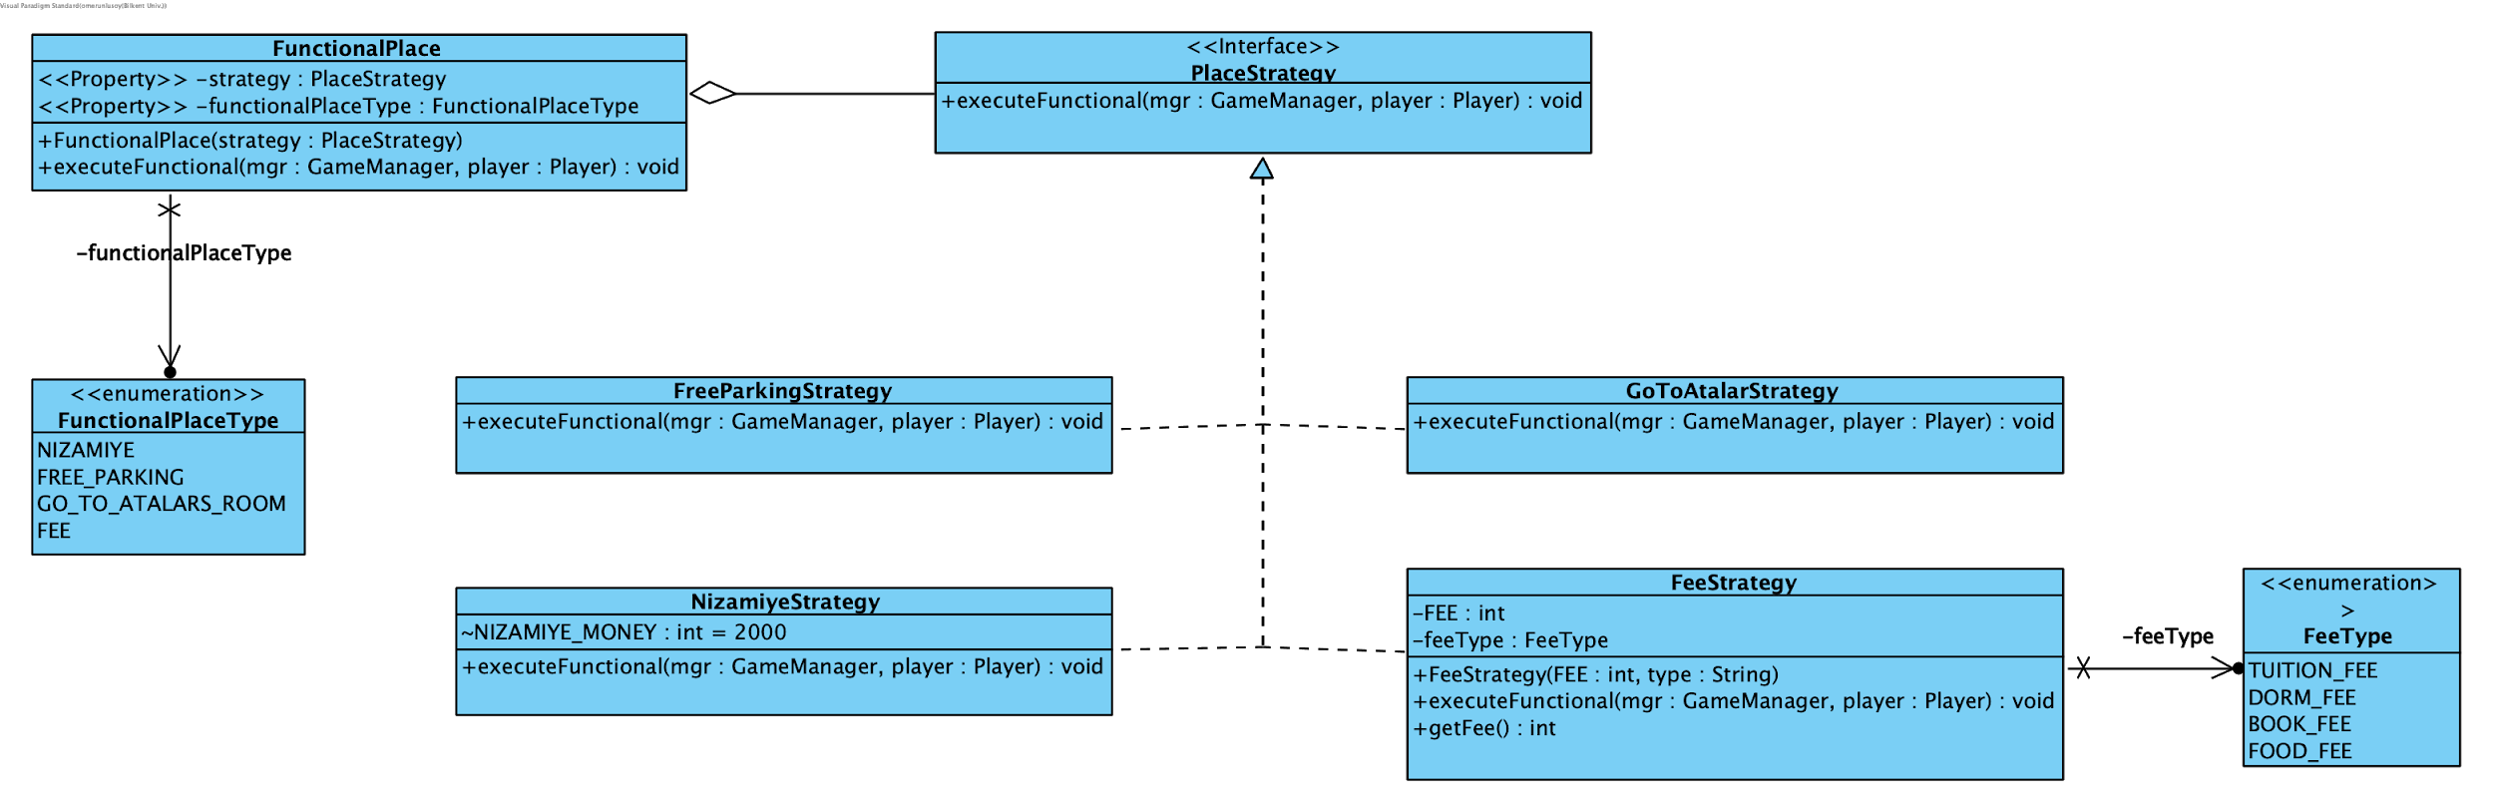
Strategy Design Pattern
Functional Places

Slide 19
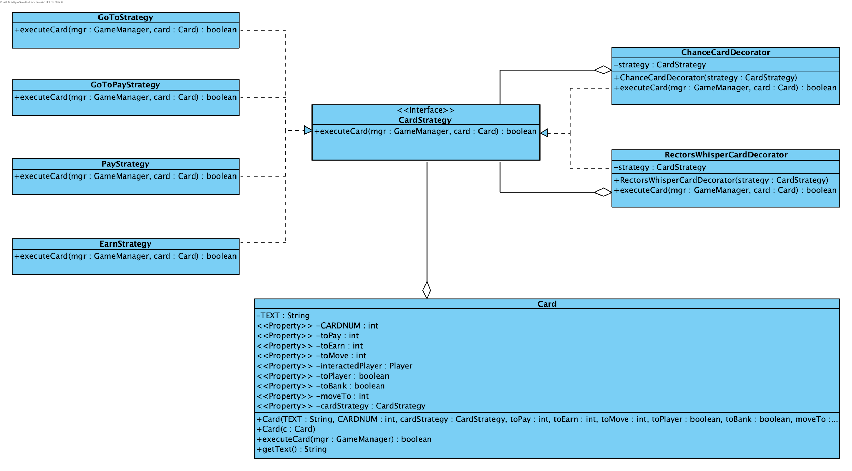
Strategy + Decorator Design Pattern
Chance &
Rector’s
Whisper
Cards

Slide 20
Thanks for Listening

Slide 21
Demo

